Slide 1






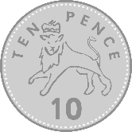





Slide 2




Slide 3



NEXT

Slide 4


Slide 6
NEXT

Slide 7




Slide 9
NEXT

Slide 10


Slide 12
NEXT

Slide 13


Slide 15
NEXT

Slide 16


Slide 18
NEXT

Slide 19


Slide 21
NEXT

Slide 22


Slide 24
NEXT

Slide 25


Slide 27
NEXT

Slide 28


Slide 30
NEXT

Slide 31


Slide 33
NEXT

Slide 34

THE END

