Slide 2
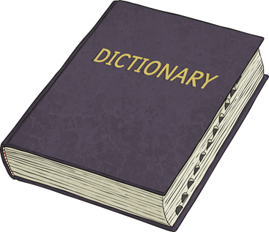
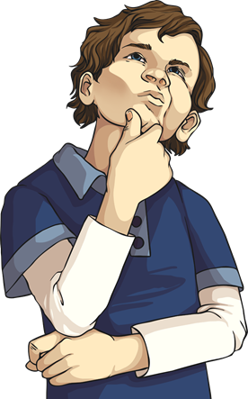

Quick Comparison
What is a dictionary?
What is a thesaurus?
What is the difference between them?

Slide 3
Quick Comparison
A dictionary is a book which lists words and tells you what they mean.
A thesaurus is a book which lists words and gives alternative words which mean the same thing.
If you want to know what a word means, you would check a dictionary.
If you want to find a synonym for a word you already know the meaning of, you would check a thesaurus.

Slide 4
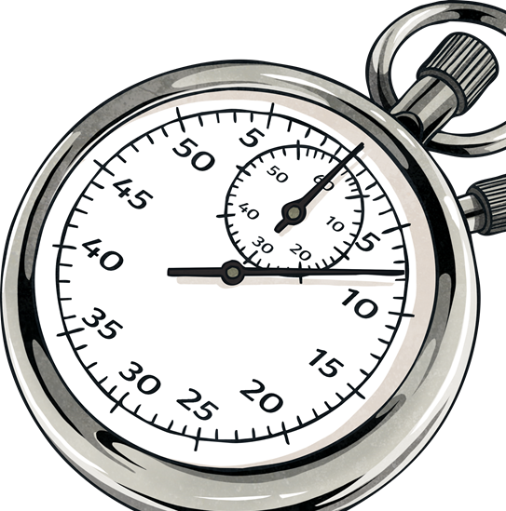
Alphabetical Order
All of the words inside a dictionary are in alphabetical order. This makes it a lot quicker to find the words you need.
Some dictionaries have marks along the edge of the pages. These marks show you where each new letter begins. Does your dictionary have these?
How quickly can you find the definitions of these words?
sad
lonely
excited

Slide 5
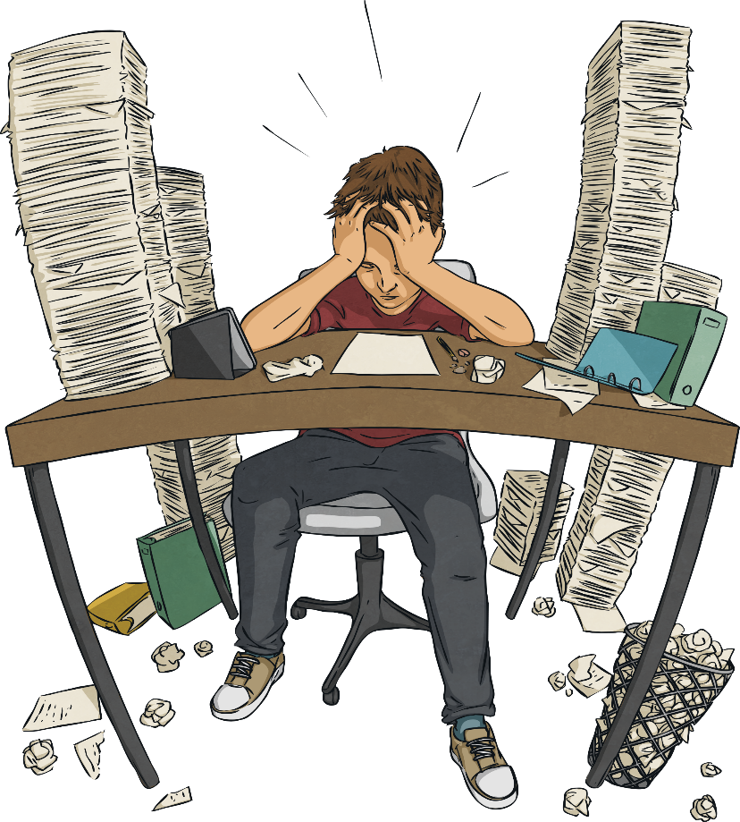
Using a Dictionary
Dictionaries are really useful when you’re trying to find the meaning of a word you’re unsure about. However, words may sometimes have more than one meaning. You will need to think carefully in order to choose the correct definition.
For example, Jenny has found this sentence in her book:
Jenny is unsure what the word produce means. She looks it up in the dictionary and finds two definitions:
Hamish was asked to produce his best piece of work.

Slide 6

Using a Dictionary
Hamish was asked to produce his best piece of work.
Produce
verb To make something using creative skills.
noun A collection of natural products.
Which definition do you think is correct in this case?

Slide 7

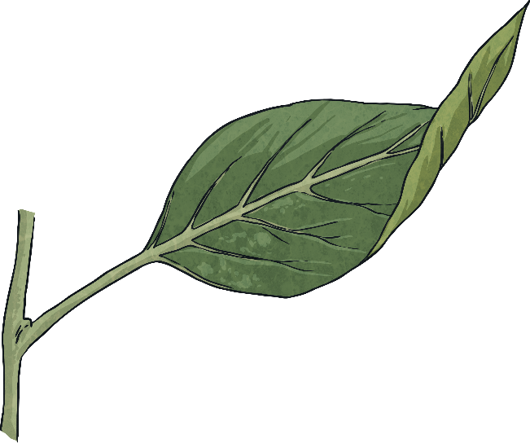
Using a Dictionary
produce
verb To make something using creative skills.
noun A collection of natural products.
Jenny tries both of the definitions in her sentence:
Hamish was asked to make something using creative skills.
Hamish was asked to collection of natural products.

Slide 8
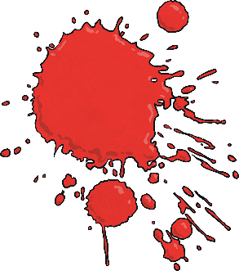
Using a Dictionary
Hamish was asked to make something using creative skills.
Hamish was asked to collection of natural products.
Jenny decides that the first definition is correct. In her sentence, the word produce meant to make something using creative skills.
What else could Jenny have done to check which definition was correct in this case?

Slide 9
Using a Dictionary
produce
verb To make something using creative skills.
noun A collection of natural products.
In Jenny’s dictionary, the definitions also tell you the word class that the word belongs to. In this case, the word produce has a different meaning depending on whether it was used as a noun or a verb.
When Jenny looked at her sentence again, she realised that the word produce was being used as a verb. Therefore, the first definition must
be correct.
Hamish was asked to produce his best piece of work for a class display.
Now, it’s your turn to decide on the correct definition.

Slide 10
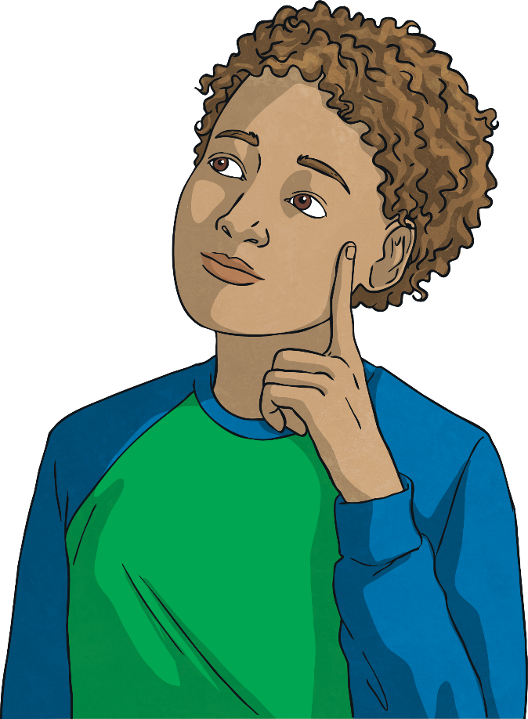

Selecting Definitions
Which of these definitions is correct in the context of this sentence?
With a flurry of signatures, the contract was finally signed.
contract
verb To catch or develop a disease or infection.
contract
noun A legal document.

Slide 11

Selecting Definitions
Which of these definitions is correct in the context of this sentence?
I watched Ms Kelly wind the wire around the reel.
wind
verb To pass something around a thing.
wind
noun The natural movement of air, especially from a particular direction.

Slide 12
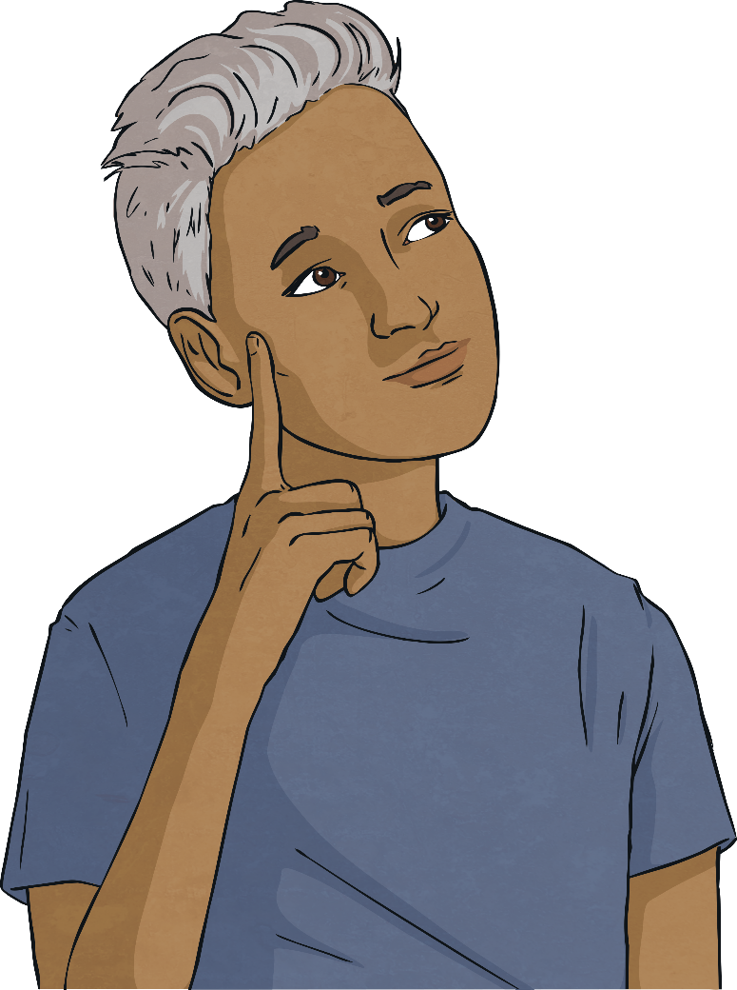
Selecting Definitions
Which of these definitions is correct in the context of this sentence?
The seeds were planted in one long row.
row
verb To move a boat using oars.
row
noun A straight line.
row
noun An argument.

Slide 13

It’s Your Turn
On each of the following slides, a sentence will be given with one word in bold.
Use your dictionary to find the correct definition.
If there are multiple definitions, remember to look at the word class and check that the definition works within the sentence.
How quickly will you be able to find the word in your dictionary?

Slide 14

Use Your Dictionary
Find the correct definition in your dictionary.
We spent the weekend having a peaceful amble around the local botanical gardens.
Did you find the correct definition?

Slide 15
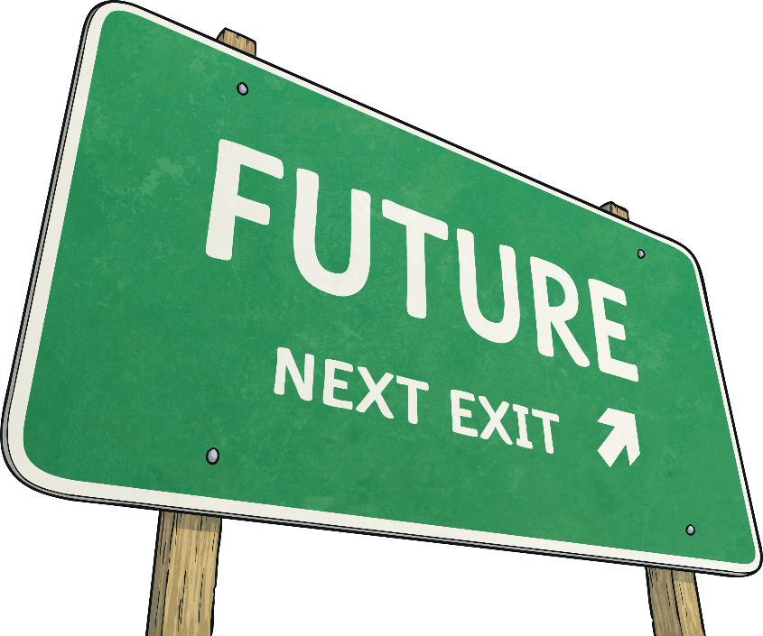
Use Your Dictionary
Find the correct definition in your dictionary.
The large, green sign warned us not to deviate from the set route.
Did you find the correct definition?

Slide 16
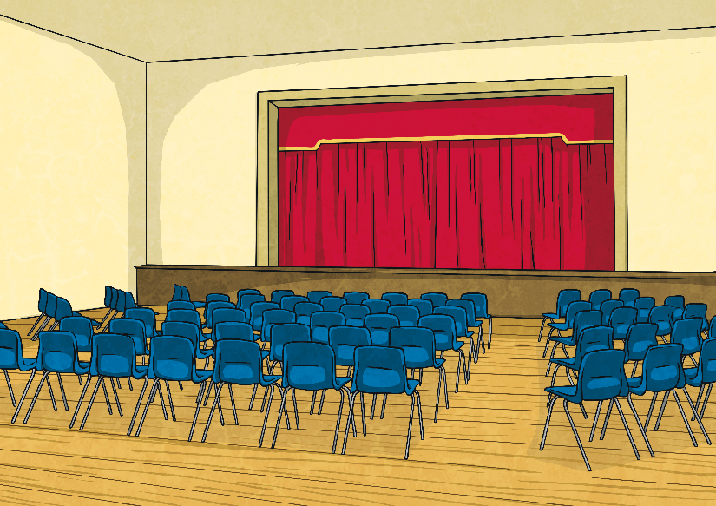
Use Your Dictionary
Find the correct definition in your dictionary.
“This class has produced some stupendous work this week,” announced the headteacher during assembly.
Did you find the correct definition?

