Slide 2
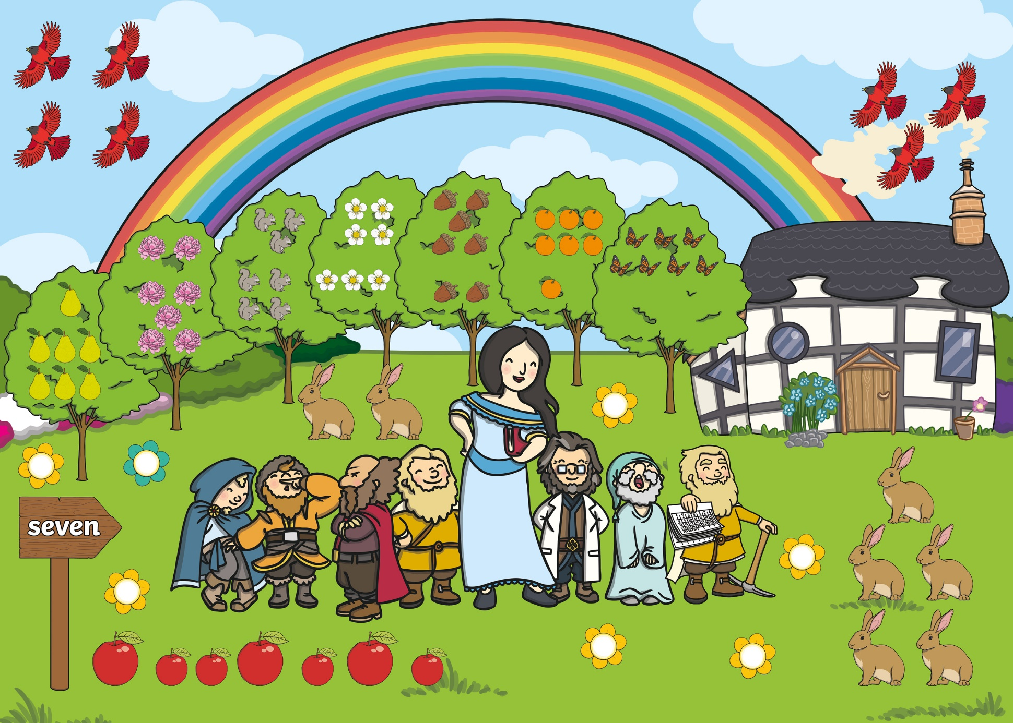
7

Slide 3

back to the picture
next

Slide 4
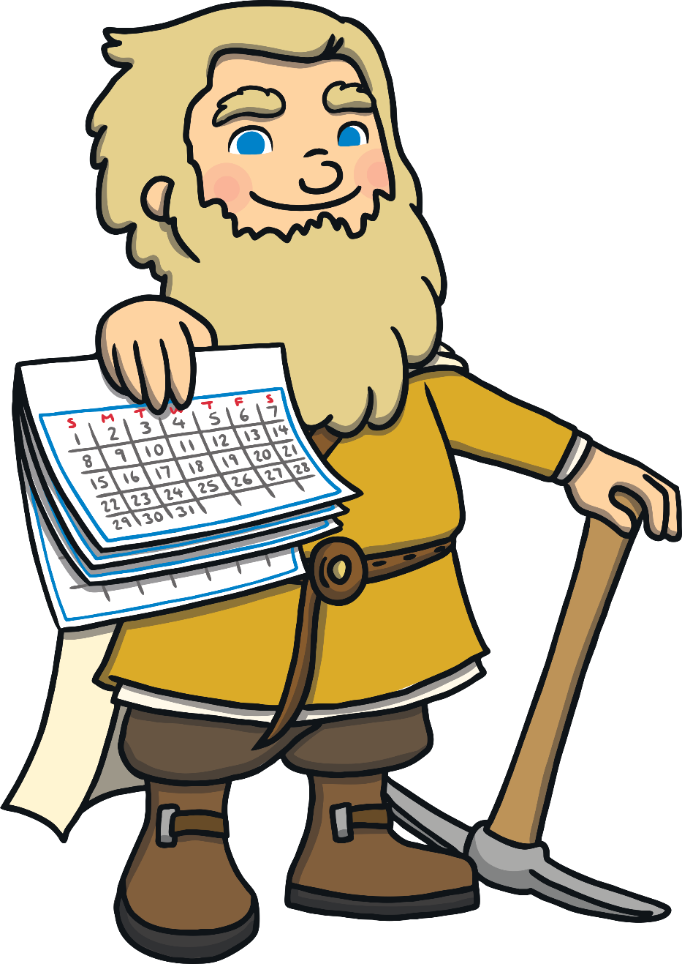
back to the picture
next

Slide 5

back to the picture
next

Slide 6

back to the picture
next

Slide 7


seven
back to the picture
next

Slide 8
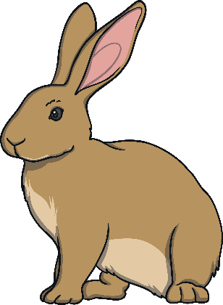
back to the picture
next

Slide 9


back to the picture
next

Slide 10

7
back to the picture
next

Slide 11


back to the picture
next

Slide 12
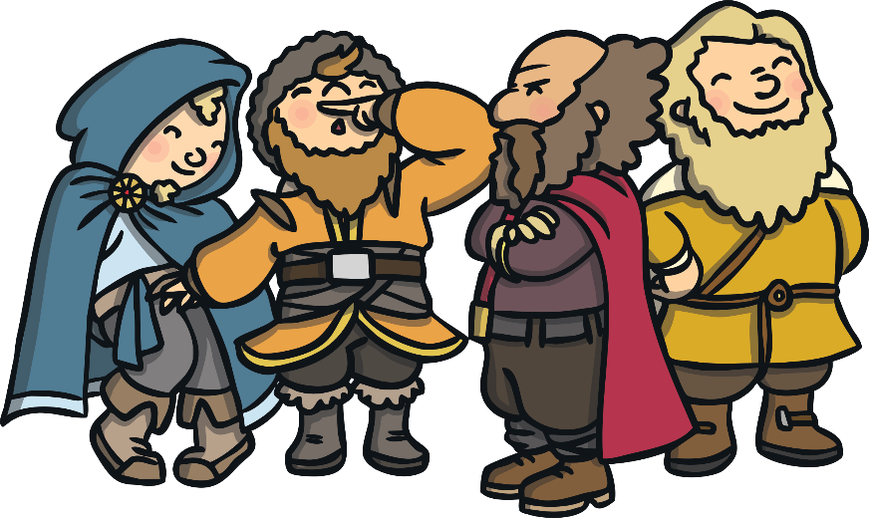
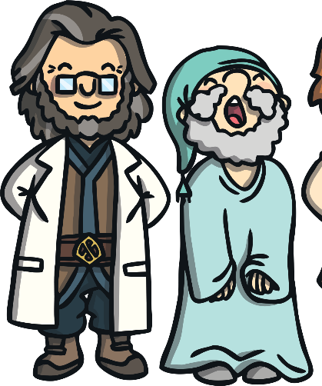

back to the picture
end

