Slide 2
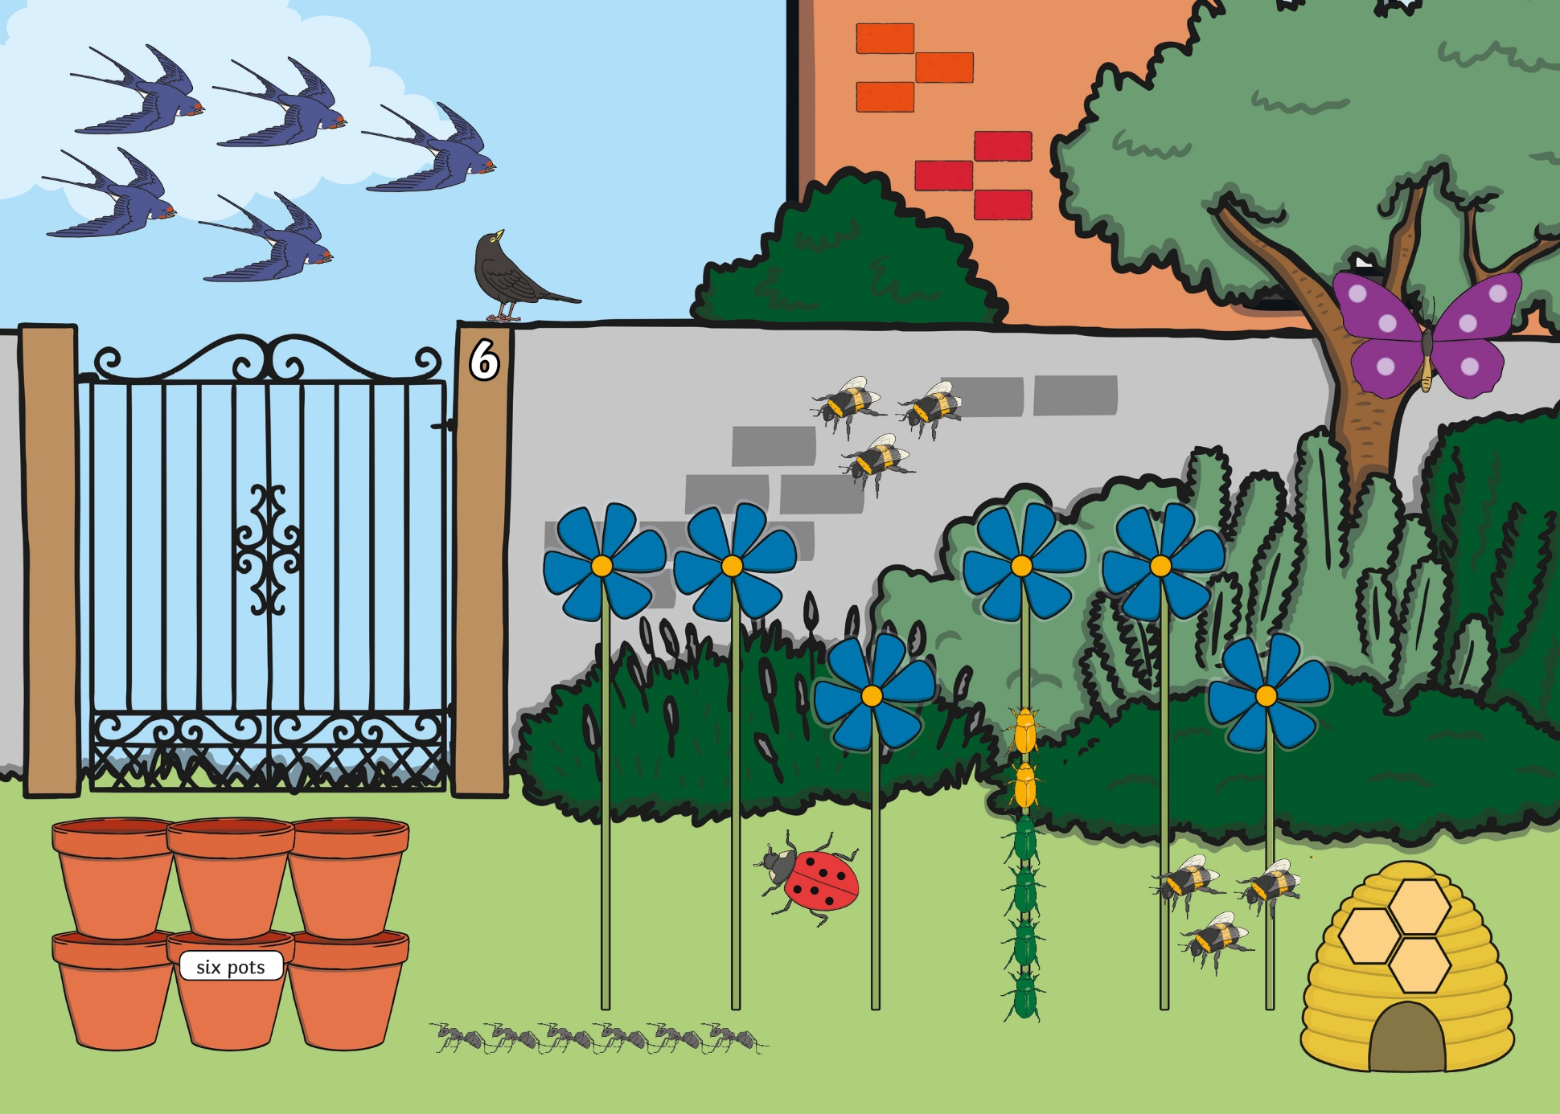

Slide 3


back to the picture
next

Slide 4

back to the picture
next

Slide 5

back to the picture
next

Slide 6

back to the picture
next

Slide 7
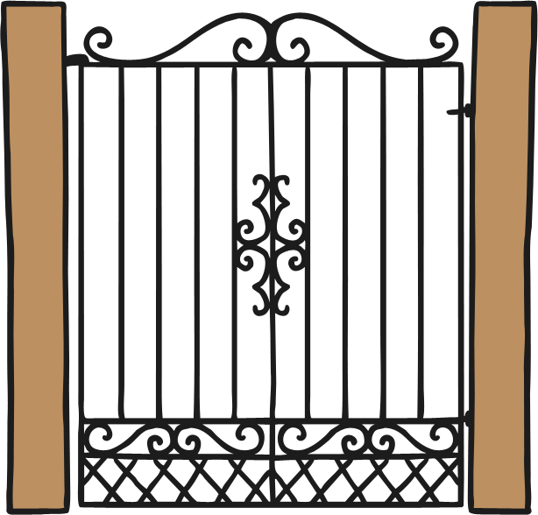
6
back to the picture
next

Slide 8

back to the picture
next

Slide 9



back to the picture
next

Slide 10


back to the picture
next

Slide 11

back to the picture
next

Slide 12
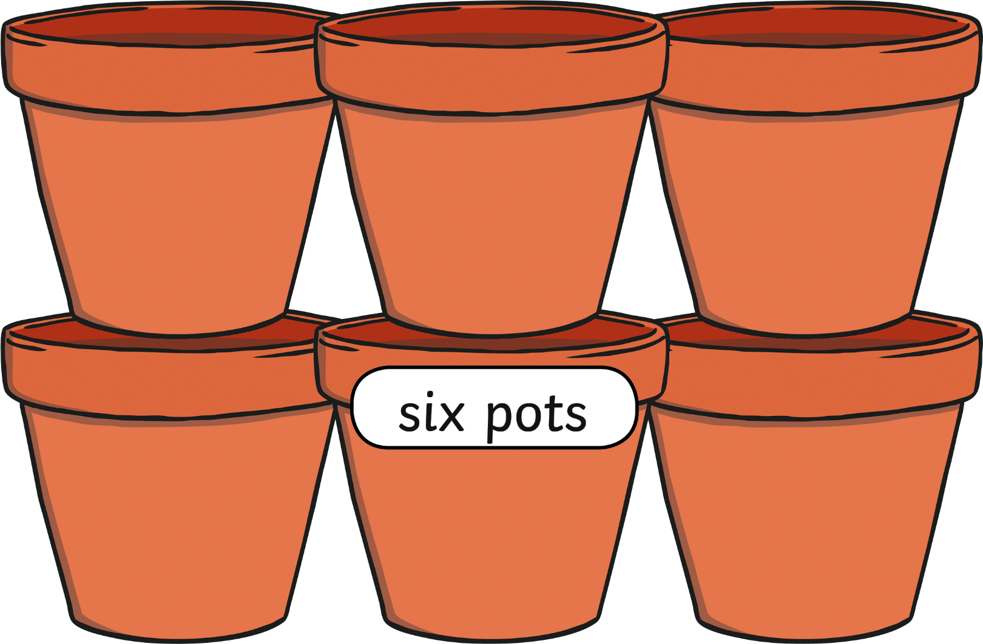
back to the picture
end

